Slide 1
Public Key Infrastructure COS 432: Information Security
Nick Feamster

Slide 2
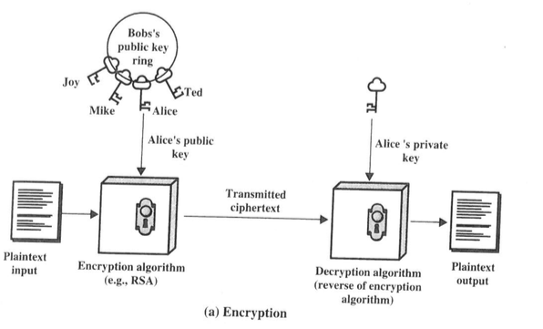

Slide 3
Public Keys
“It is crucial that the public file of enciphering keys be protected from unauthorized modification.”
Questions
Where is the public directory?
Who runs it?
How do we get access to it?
Partial answer: Certificates

Slide 4
Certificate
Binds an entity to a public key
Signed by some issuer (certification authority) Contains the identity of issuer
Includes an expiration time

Slide 5
Public Key Infrastructure
People, policies, and procedures for creating, managing, storing, distributing, and revoking digital certificates based on asymmetric cryptography.
Questions
Who signs the certificate?
Do you trust them?
Are they honest, competent, etc.?

Slide 6
Public Key Infrastructure
Infrastructure to create, distribute, validate revoke certificates
A small number of roots hierarchically certify various entities (“Certificate Authorities”)
Clients trust roots, transitively follow chain of trust from server back to root
Standard: X.509 (hence “the PKI”)
Notes:
Clients are browsers, email programs, IM programs, etc.

Slide 7
Problem: Trust Anchors
How does browser know Facebook’s cert was supposed to be
signed by DigiCert and not another CA?
Because Facebook told it!
Oops! What if we’re talking to fake-FB and fake-FB provides a
different certification authority?
Theory: user accepts only if she trusts the new CA
Practice: Firefox comes with a list of CAs
We’re in trouble if any one is malicious!
Can MITM any site on the Internet

Slide 8
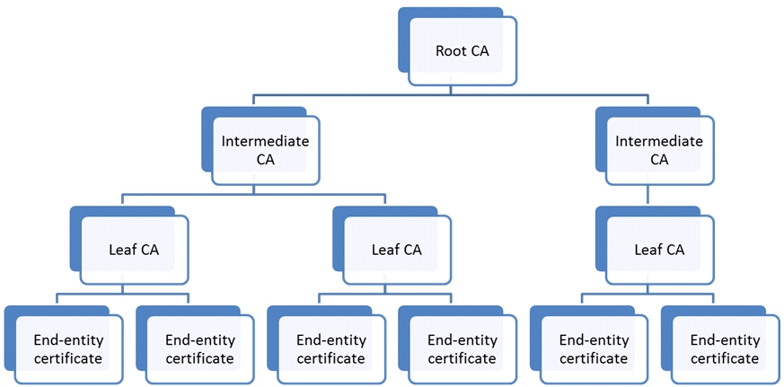
Certificate Authority Hierarchy (Old)
Today: Flatter Hierarchy, Multiple Roots
Notes:
Out of date in two important respects: we have multiple roots, and the hierarchy has (mostly) collapsed.
(Hierarchy can still technically be deep, but rarely happens in practice.)
What’s an example of a root CA we saw so far? DigiCert.

Slide 9
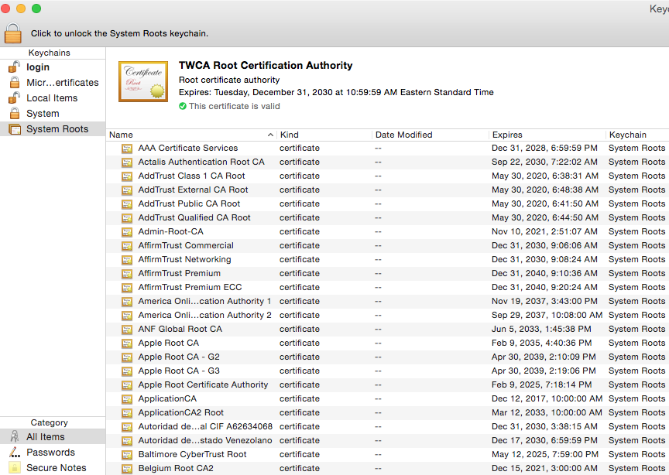
Today: Nearly 200 Roots of Trust!
Mozilla: 150 CAs from 60 organizations
Any can create unrestricted sub-CAs
Vendors will update this list automatically!
Notes:
What I mean is that there are 70 unique values for the “owner” field. There are almost 200 unique root certificates (rows in this table).

Slide 10
Some Concerns
Which CAs are trusted?
What is a certificate’s intended use?
How trustworthy is a given CA?
Insight: Every function that requires a certificate should have its own PKI (Bellovin)
If the CA is authoritative for the namespace concerned, then many of the complexities of managing a PKI go away

Slide 11
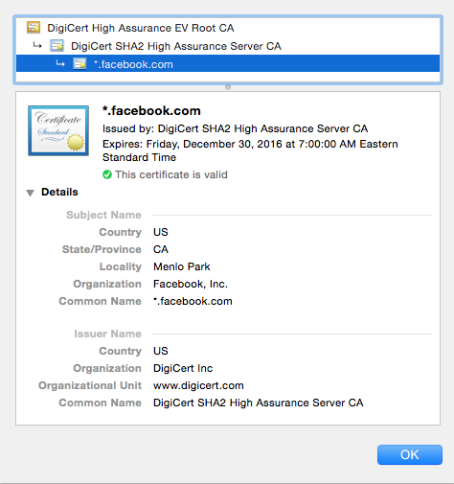
Example of Signed Certificate

Slide 12
Web: Two Types of Certificates
Domain Validation
Binding between domain name and public key
Extended Validation (higher assurance)
Binding between company/entity name and public key

Slide 13
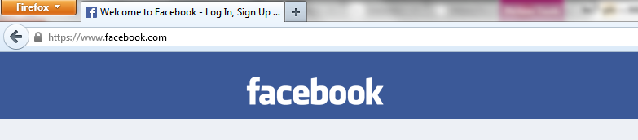
Domain Validation Certificates
Usually Automated
Email-Based
But email is not secure!
Still it raises the attacker’s bar
Notes:
Why doesn’t Gmail get an EV cert?
http://security.stackexchange.com/questions/52387/does-google-use-extended-validation-certificates

Slide 14
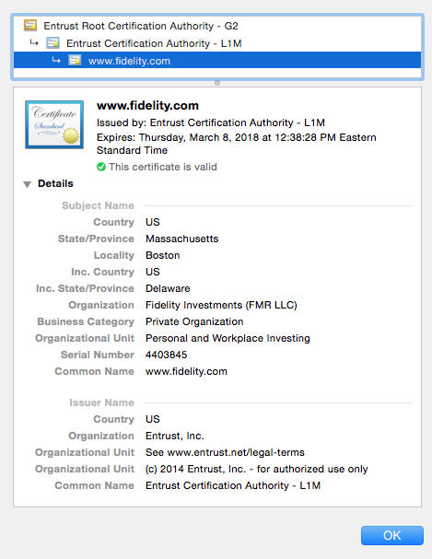
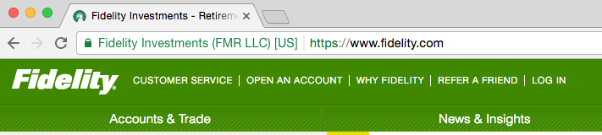
Extended Validation Certificates

Slide 15
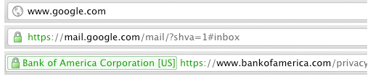
Notice the URL bar
Insecure
Domain validation
Extended validation
Notes:
Average user won’t notice, which is a problem, but it’s still useful
-- helps protect high risk, educated users
-- as long as the infrastructure is in place, software can later evolve to more strongly warn the user when entering credentials into insecure sites

Slide 16
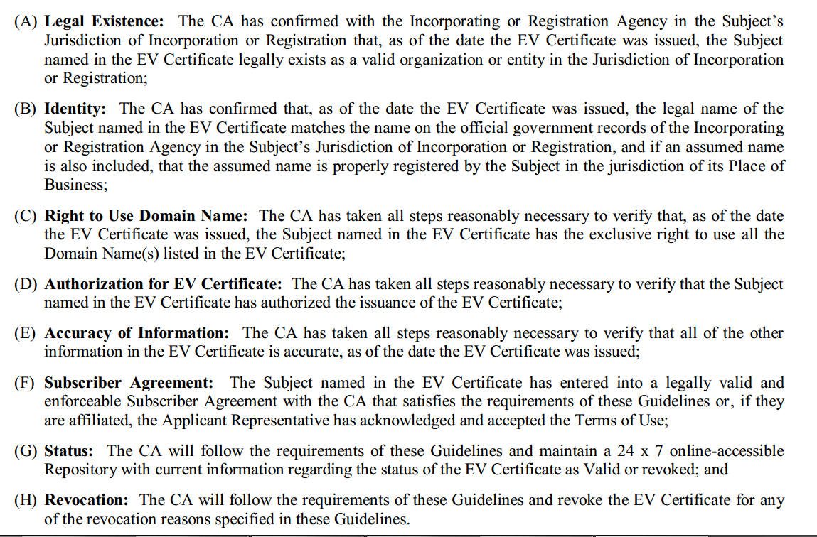
CA/Browser Forum: Extended Validation Guidelines
Notes:
CA/browser forum is the organization that comes up with guidelines for Extended Validation. https://www.cabforum.org/EV_Certificate_Guidelines.pdf‎
This is what ensures that the user can look at the name of the entity to whom the cert is issued and it will intuitively match what they expect.

Slide 17
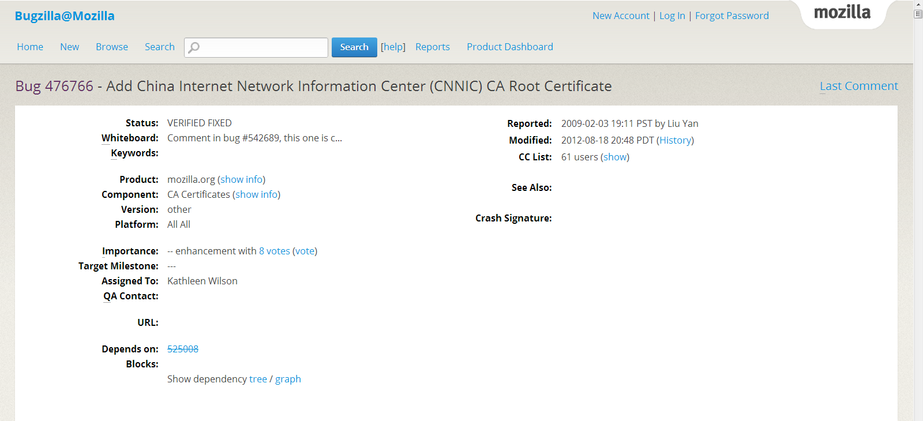
Getting Root CA Added to Mozilla: Bugzilla
Notes:
CNNIC wants to be added as a root CA, makes bugzilla request (2009)
https://wiki.mozilla.org/CA:How_to_apply

Slide 18
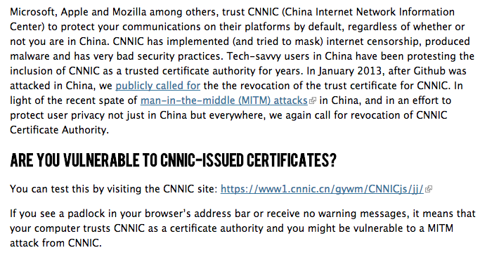
Notes:
https://en.greatfire.org/blog/2014/oct/apple-and-microsoft-trust-chinese-government-protect-your-communication
Mozilla requests audit report, CNNIC provides it
Gets put into a processing queue
A few months later case is opened for public comment
One week, no public comment, CNNIC added to root CA list
Shit hits the fan – Chinese users claim CNNIC is controlled by the government, has been known to MITM before
No action is taken – CNNIC remains in the FF root CA list
Early 2015 – Google catches CNNIC issuing certs used for MITM. Chrome and FF kick out CNNIC from list of root CAs, but Microsoft and Apple keep them on. This is a somewhat strange situation

Slide 19
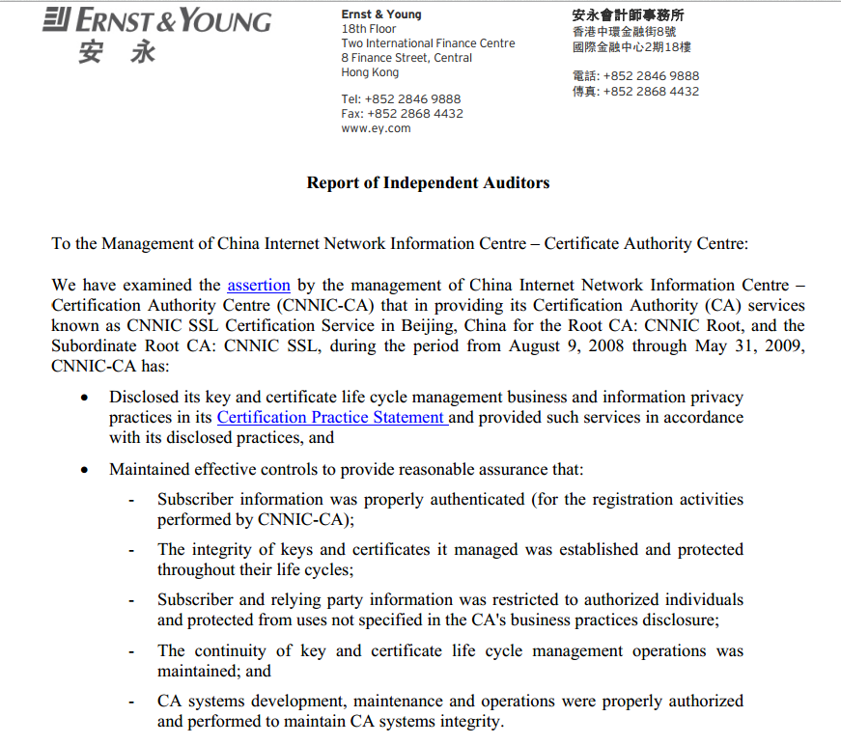
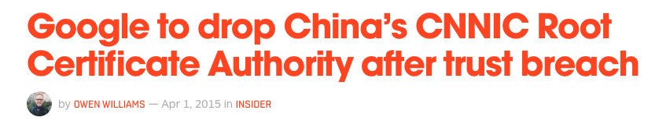
Notes:
Mozilla requests audit report, CNNIC provides it
Gets put into a processing queue
A few months later case is opened for public comment
One week, no public comment, CNNIC added to root CA list
Shit hits the fan – Chinese users claim CNNIC is controlled by the government, has been known to MITM before
No action is taken – CNNIC remains in the FF root CA list
Early 2015 – Google catches CNNIC issuing certs used for MITM. Chrome and FF kick out CNNIC from list of root CAs, but Microsoft and Apple keep them on. This is a somewhat strange situation

Slide 20
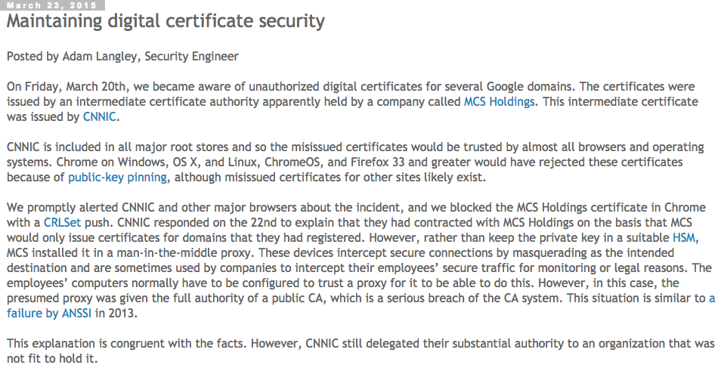

Slide 21
IP Addresses: Resource Public Key Infrastructure
Resource certificates: Digitally signed statement that says a particular entity owns a prefix
Certificates bind IP prefixes to public keys
Resource owner uses this certificate to create a ROA
Allows routers to reject route advertisements from organizations that do not own the prefixes
More when we get to network security…

Slide 22
DigiNotar Hack
Dutch CA DigiNotar compromised in 2010
(likely by Iranian government)
Fake certs issued for *.google.com
Used to MITM unknown number of Iranian users
One month later: problems detected by Iranian ISPs, fake cert quickly published
Company went out of business ☺
Notes:
Another unfortunate property of the PKI system (as it exists today) is that CAs make money from the entities they issue certs to, i.e., the entities they’re supposed to be protecting the public from.
This means there’s a perverse incentive to have looser rules so that they can have more customers .

Slide 23
SSL Errors (https://badssl.com/)
Expired Certificate
Wrong Host
Self-signed Certificate
Untrusted Root
Old version of SHA-1
Mixed Content
Bad Ciphersuites

Slide 24
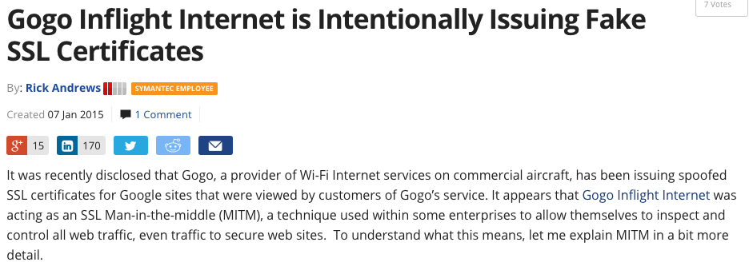
Some companies do this, to allow them to decrypt all traffic…

Slide 25
Rogue Certificate Authority
Issue rogue certs for target sites
Select users to target, install MITM boxes at their ISP(s)
Game on (Do the actual MITM, collect data)
Notes:
This is of course not trivial. But we still consider it a problem, because crypto won’t protect us.

Slide 26
Obtaining a Certificate (Server)
Server generates key pair, signs public key and ID info with private key
Proves server holds private key
Provides message authentication
CA verifies server’s signature
Uses the server’s public key to verify itself!
How does it verify it’s actually the server?
CA signs server’s public key with CA key
Creates a binding
Server verifies key, ID, and CA’s signature
Server publicizes its newly obtained cert
Punt on the hard problem
Notes:
From http://www.cypherpunks.to/~peter/T2_Key_Management.pdf
Here server = facebook (say), CA = DigiCert (say)

Slide 27
Validating a Certificate (Client)
Path construction
server could supply intermediates
the more sources the merrier
Path validation
Check signatures
Check expiry dates, revocation, etc.
Notes:
Details not important here.
Basically the client verifies a chain of certificates starting from root CA and ending at the server you’re talking to (e.g., Facebook).

Slide 28
X.509, SSL, TLS
X.509 full spec thousands of pages
SSL/TLS utilize X.509 for key distribution perform (session) key exchange & encryption
Impossible for mortals to get right Rely on years of attacks, fixes, and reviews

Slide 29
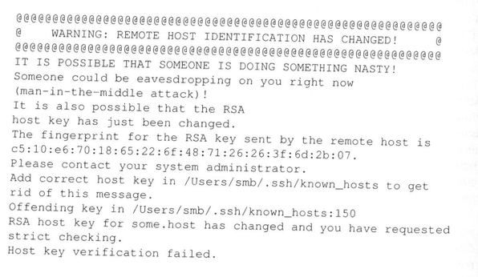
Certificate / Key Pinning: Detecting MITM
Public keys rarely change
Alert user when change occurs
Variant: Check when the issuing CA has changed

Slide 30
DANE: DNS Authentication of Named Entities
Store sites’ certificates in DNS
Administrator of domain name certifies keys for that domains clients and servers
Protected by DNSSEC (Still need one cert: one for the root of the DNS hierarchy)
Eliminates the need for a certificate authority
Depends on the deployment of DNSSEC

Slide 31
Certificate Transparency
Every CA logs the certificate it issues
Browsers notice if two different CAs issue a certificate for some site
Drawback: Requires universal compliance
Otherwise a CA that does not participate in CT can issue bogus certificates

Slide 32
Certificate Expiration
Probability of undetected compromise is high
(Reading has some useless mathematical exercises.)
Algorithms age, weaknesses are discovered
Eases bookkeeping with respect to revocation
No need to keep track of revocations for expired certificates

Slide 33
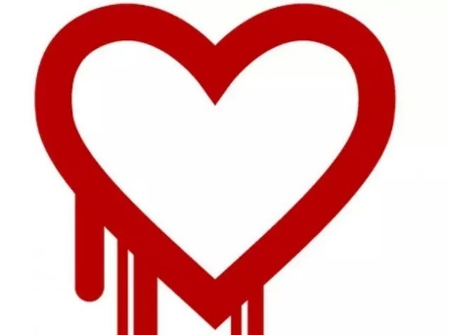
Certificate Revocation
Key may be lost or stolen, identity may change
e.g.: After Heartbleed,
over 80,000 certs revoked

Slide 34
Two Mechanisms for Revocation
Certificate Revocation List (CRL)
File of revoked certificates signed by the CA
URL of list is included in certificates
Includes time of next update
Online Certificate Status Protocol (OSCP)
Online check of validity
Reduces time to revocation
In practice, however, detection is often what takes time
Notes:
Denial of service attack could prevent clients from learning about newly revoked certificates.

Slide 35
Revocation: Two Hard Problems
1. Authenticating the revocation request
If not careful, easy DoS!
Can’t ask for old key!
2. Keeping clients up to date
Offline model: Certificate Revocation List
Online model: OCSP (online cert status protocol)
Notes:
http://news.netcraft.com/archives/2013/05/13/how-certificate-revocation-doesnt-work-in-practice.html

Slide 36
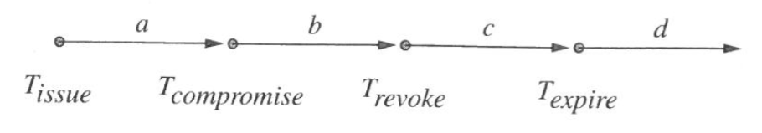
When to Rely on a Signed Message?
Analyze messages received in each interval
How to handle a message that was signed with an expired key?
Can you still act on it?
How to know when the message was signed?
Notes:
Timestamp may indicate when the message was signed, but can you trust it? Lots of time may elapse between signature and use.
Received during a: All good.
Received during b: Danger zone. Want to keep short.
Received during c: Safe if receiver checks for revocation.
Received during d: unambiguous… expired.
Not quite so simple: T_compromise is uncertain.
Also, messages may need to be acted on far after they are signed.

Slide 37
Revocation Doesn’t Work (Well) in Practice
Most browsers only check CRLs for extended validation certificates
Chrome team believes online checking is useless
Revocation lists be cached for 6 months!
Notes:
(As of 2015)

Slide 38
What about PKI for regular people?
PKI (mostly) doesn’t work for regular users

Slide 39
Client Certificates
Common in companies
Company issues certificates for users
Intranet websites accept these for login
Can also be used for signing/encrypting e-mail
A few other limited deployments
Rolled out in Estonia, several other EU countries
Not much adoption
Usability
nightmare

Slide 40
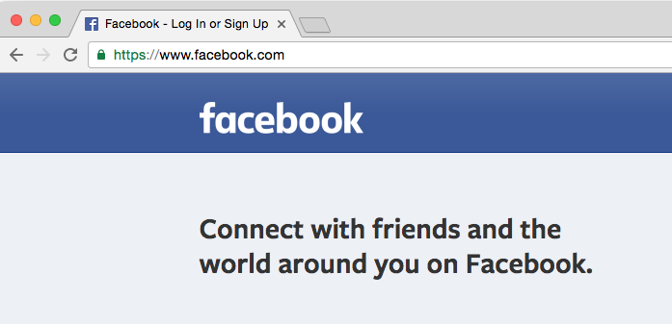
How do you know you’re looking at the “real” Facebook?
Notes:
What are my trust assumptions, in other words what could the attacker have compromised?

Slide 41
Assumptions for Authentication
HTTPS certification is working correctly
Browser is behaving correctly (Subsumes malware on my computer)
Google’s URL is indeed https://facebook.com
Not, say, https://thefacebook.com

Slide 42
Assumption 2: browser is behaving correctly
Notes:
To trust your browser, you need to trust your hardware and OS. You also need to be sure that you downloaded the browser securely. We can further break that down…

Slide 43
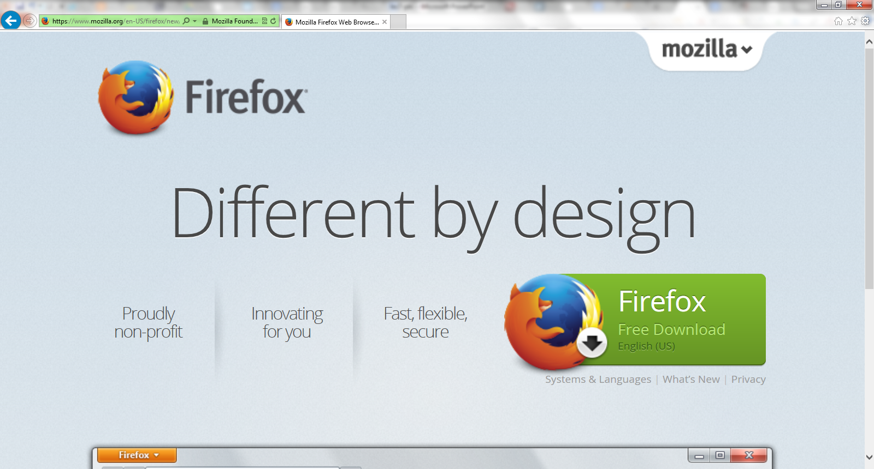
First I had to download Firefox…
Notes:
I used Internet Explorer to download Firefox

Slide 44
Three Assumptions
Internet Explorer is behaving correctly (Subsumes malware on my computer)
HTTPS certification is working correctly
Firefox’s URL is indeed https://mozilla.com/…
This assumption no longer needed!
Mozilla’s certificate is assigned to “Mozilla Foundation [US]”
✗
Notes:
I didn’t download IE (came with my computer), so no further recursion. But I have to trust Microsoft and Dell who I got the software and hardware from.
Don’t need the last one because a different type of certificate is in play. It tells me the domain belongs to Mozilla Foundation. If I know that Firefox is made by Mozilla then I’m safe. I don’t need to know what their URL is. (Extended validation, as we’ll see later. Trademark law indirectly comes into play here as well.)

Slide 45
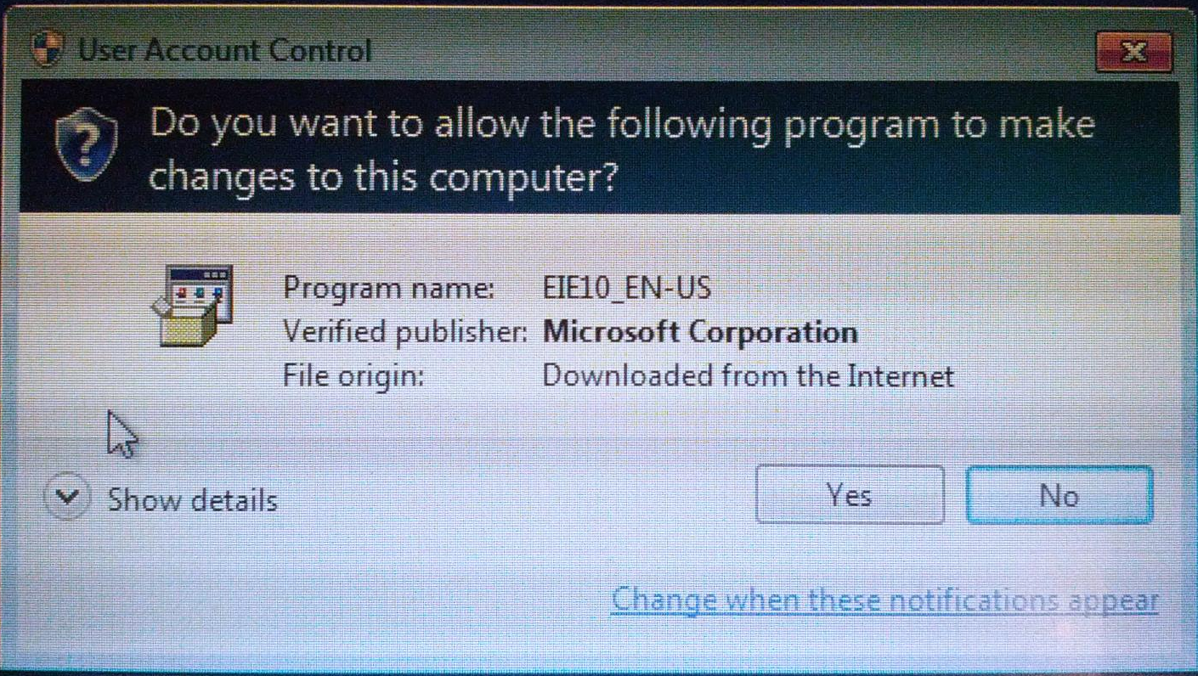
I also updated Internet Explorer
Code signing — same principle as HTTPS, different UI
Notes:
Interesting side-note: User Account Control doesn’t allow taking a screenshot. I took this pic with my phone, hence the pixelation.
The verification process here is analogous to Extended Validation certs, but a bit different.
All OSes have something similar.

Slide 46
Assumption 3: Domain is Correct

Slide 47
Typosquatting
e.g., facebook.com vs facebok.com
Discussion: what stops an attacker from registering such typos and using them for phishing?
Primarily legal measures!
ICANN enforces trademark law
Notes:
Obviously these measures are not perfect, but these days typosquatting is not a major security risk.

Slide 48
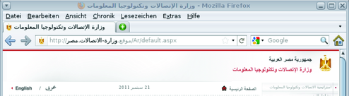
“IDN homograph attack”
https://facebook.com vs
https://fаcebook.com
Latter URL is encoded as https://xn--fcebook-2fg.com/
Unless you’ve configured your browser for Cyrillic
Try copy-pasting this into browser URL bar
URLs can contain Unicode!
IDN = Internationalized
Domain Name
Notes:
To get into the nitty gritty, here’s Chrome’s policy from the documentation at https://www.chromium.org/developers/design-documents/idn-in-google-chrome:
Google Chrome decides if it should show IDN or punycode for each component of a hostname separately. To decide if a component should be shown in IDN form, Google Chrome uses an algorithm that depends on the languages that the user claims to understand. On all platforms, these languages can be configured in the Google Chrome's Fonts and Languages dialog. On Mac OS X, they used to be derived from the system language, but not any more. The algorithm is:
Build the set of characters in the component.
If that set contains at least one blacklisted character, punycode is displayed.
If the language list is empty, the component is displayed in IDN form exactly if it contains only characters used in a single language and the following steps are skipped.
The characters 0-9, +, -, [, ], _, and the space character are removed from the set.
If all the remaining characters belong to a single of the languages in the language list as described below, the IDN form is displayed. Otherwise punycode is shown.

Slide 49
“The most dangerous code in the world”
Major SSL clients (not browsers) are broken
Shopping cart libraries (incl. Amazon and Paypal)
Instant messengers such as AIM and Trillian
Chase mobile banking app
Broken in hilarious ways
e.g., forgets to check if it’s the right domain name
When presented with a certiﬁcate issued to AllYourSSLAreBelongTo.us instead of the expected Amazon or PayPal or Chase certiﬁcate, these programs eagerly establish SSL connections and spill out their secrets
Notes:
http://www.cs.utexas.edu/~shmat/shmat_ccs12.pdf
How did the authors get an SSL cert for that domain? Well anyone can get a Domain Validation cert for any domain they own. There are no restrictions, no criteria other than being in possession of the domain. This is not a bug.
The bug is that SSL cert validation software doesn’t check if the cert that the server is providing is actually for its own domain or for a totally different domain.

Slide 50
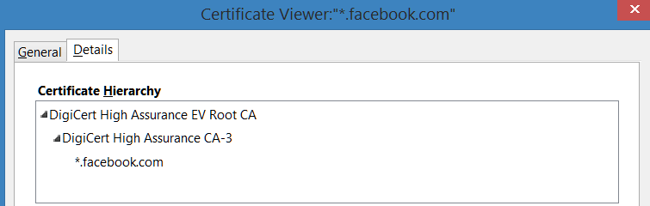
This is why Firefox believes it’s the right FB
Firefox comes baked in with DigiCert’s public key
DigiCert signed Facebook’s public key
Notes:
Firefox comes baked-in with DigiCert’s public key. ← Trust anchor or root of trust.
We’ll ignore the fact that there are two levels of DigiCert, treat them as one.
Theoretically the hierarchy can be arbitrarily deep.

Slide 51
Firefox
Correct domain
Cert
Mozilla
Download
DigiCert
Internet Explorer
X
Cert
Firefox
Correct domain
Microsoft
Dell
Update
Some CA
Microsoft
Cert
Some CA
Notes:
If any of these boxes/assumptions fails, I could be entering my password into a phishing site (or a man-in-the-middle).
Orange boxes are roots of trust. This is an inverted tree. The leaves here are actually the roots (anchors) of trust. We can’t further reduce the trust assumption. e.g., I either trust Mozilla or I don’t.
We could either consider DigiCert a root of trust we could say that we only trust DigiCert because Firefox trusts it. In the latter interpretation we’d expand the CA nodes until we’re left with only browser vendors, OS vendors, and hardware vendors.
Note that the CA in the bottom node is trusted by the OS (which has its own store of root certificates), and need not be trusted by a browser.

Slide 52
What’s NOT here
Wireless router manufacturer
Internet service provider
Government
Discussion: why are these entities unable to mount an attack?

Slide 53
MITM is not possible
Recall: authenticated key exchange
Crypto removes the need for trusting the network
Notes:
This is perhaps the main achievement of crypto in Internet security. You have to trust the software you’re running, and the party you’re talking to at the other end (e.g., you can’t protect yourself from Facebook selling your password to someone else). But crypto ensures that it’s irrelevant if the nodes in the network in between are malicious. At best they can cause a Denial of Service.
(Well, subject to some assumptions, which we’ll see next.)
Note: Authenticated D-H KE and RSA-KE are both fine. D-H additionally offers forward secrecy, but that’s not relevant to this discussion.

